Slide 1
ENG 10
Fundamentals of Engineering Applications
Project QuikPark
2018-03-15

Slide 2



Team 5 - Minions
Aldo Siswanto
Power Point
Saketh Madamala
CAD
Yongji Shen
Programming
Debugging
Nuoyi Yang
CAD
3D Printing
component re-work

Slide 3
Why are we doing this?
The parking process takes a long time.
People might lose their parking tickets.
It is a hassle to renew parking tickets every few hours.
Saves people time.
Prevents excess traffic in parking structures.

Slide 4
So what do we need?
Design Requirements:
Detect if the car is there. Detects a change in color by utilising the light sensor.
Determines the length of time the car is parked.
Can be used with a further algorithm to calculate the price of the parking ticket for the car.
Adafruit not sensitive to changes in brightness (reduced accuracy in determining if the car is there).
Should detect change in colour instead of a change in brightness.

Slide 5
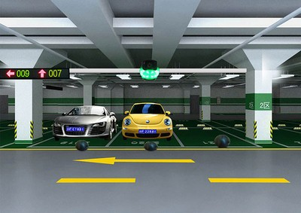
So here is what we came up with!

Slide 6
The QuikPark utilises an Adafruit Circuit Playground
The light sensor detects a change in color every 3 seconds.
We set the sampling frequency to 3 seconds to prevent false alarms caused due to random changes in color in the surroundings.
If the sensor color value changes between the first scan and the second scan:
If the new sensor value persists to the 3rd scan, then we start the timer.
If the new sensor value changes again in the 3rd scan, then it’s just a false alarm and we do not start the timer.

Slide 7
Same procedure occurs as the car exits the parking spot. If the sensor values change between scans:
If the new sensor value persists to the 3rd scan, then we stop the timer.
If the new sensor value changes again in the 3rd scan, then it’s a false alarm and timer continues.
The program displays the time of parking.

Slide 8
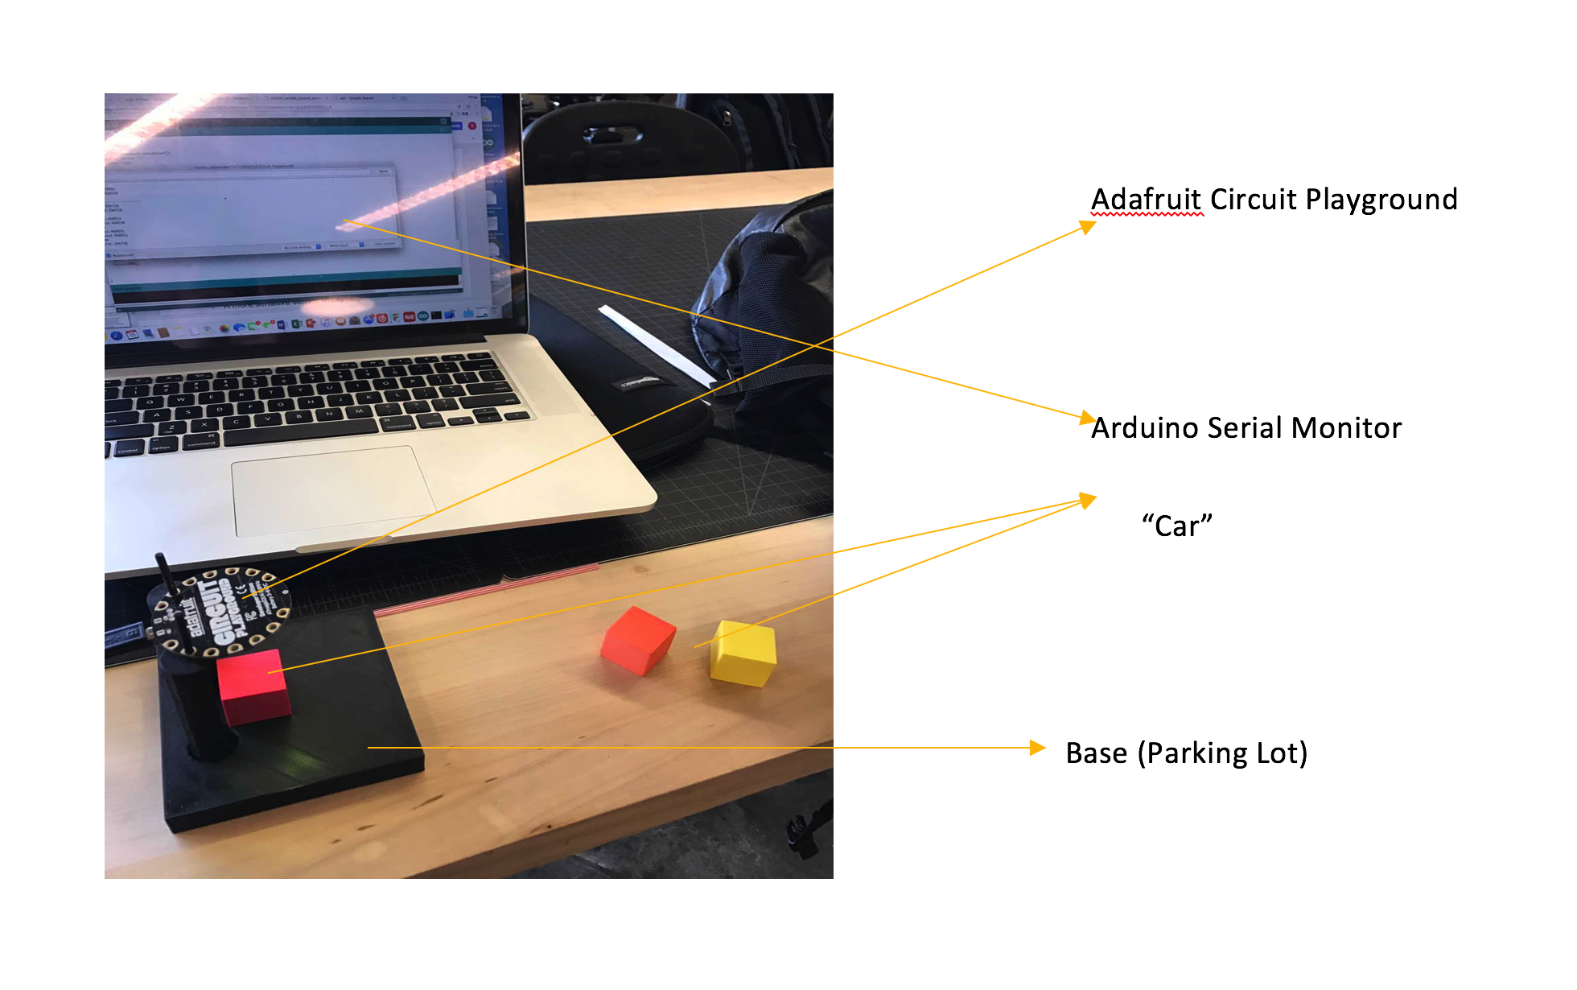
Prototype

Slide 9
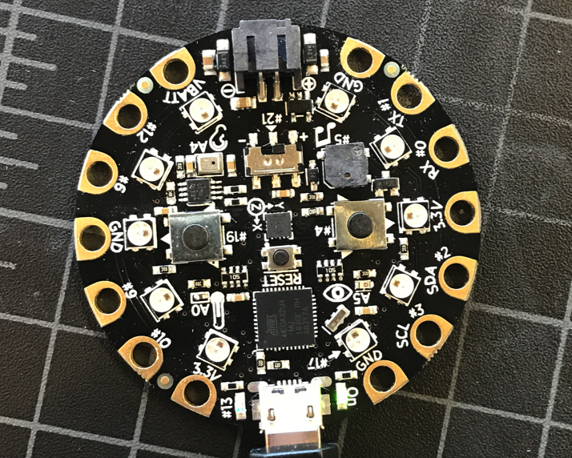
How Sensor Works
Begin

Slide 10
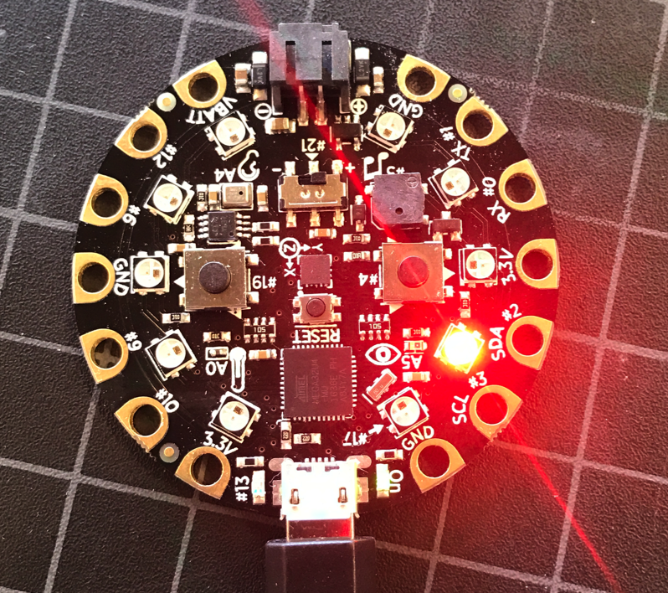
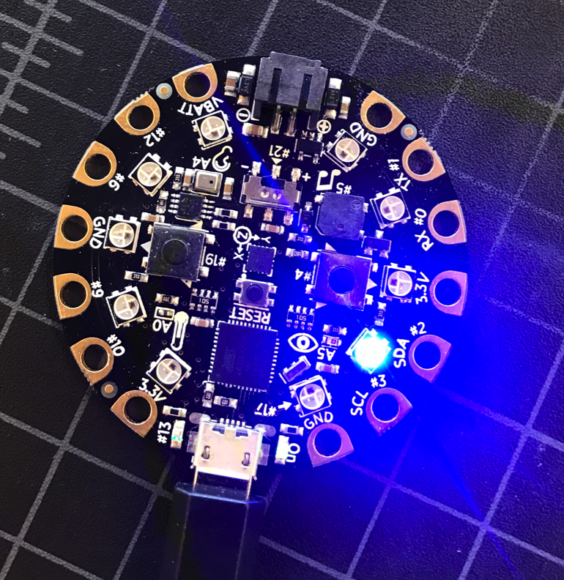
How Sensor Works
Light Sensor reading color

Slide 11
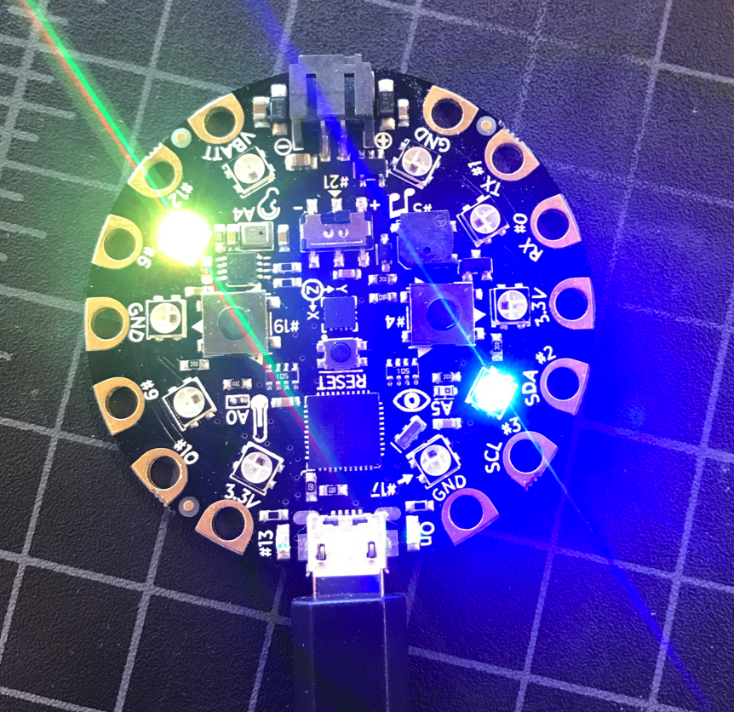
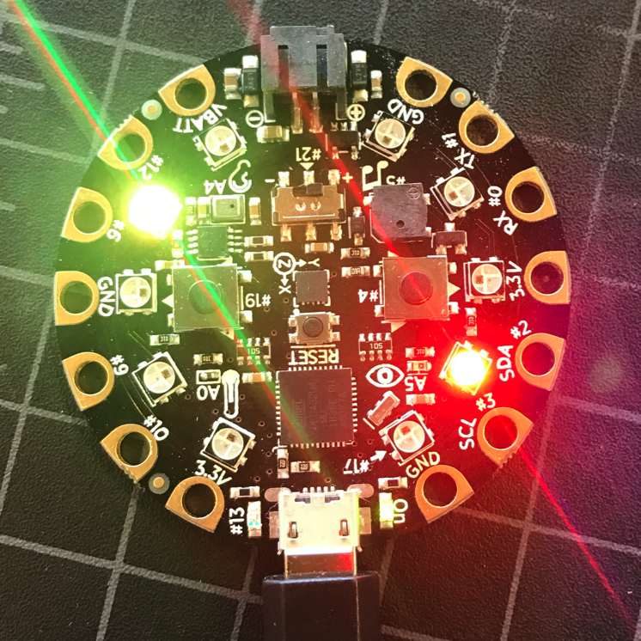
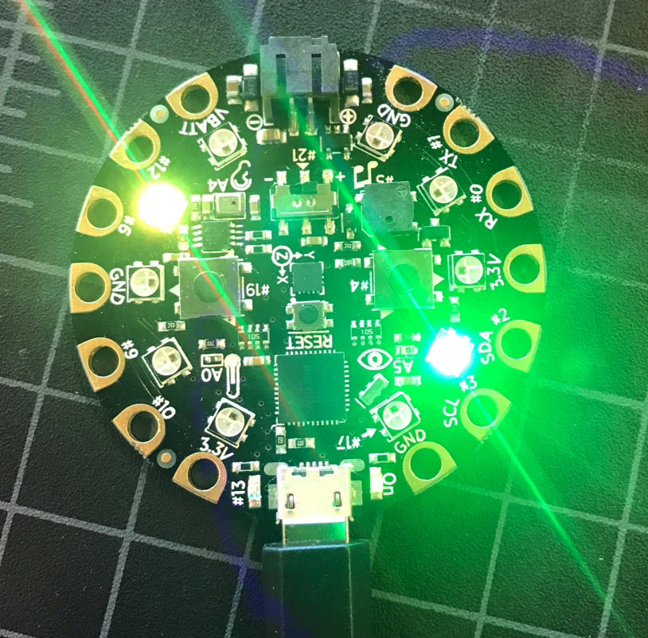
How Sensor Works
Find something, system is confirming there is a car on parking space.
Green light is on, which means something is on this parking space.

Slide 12
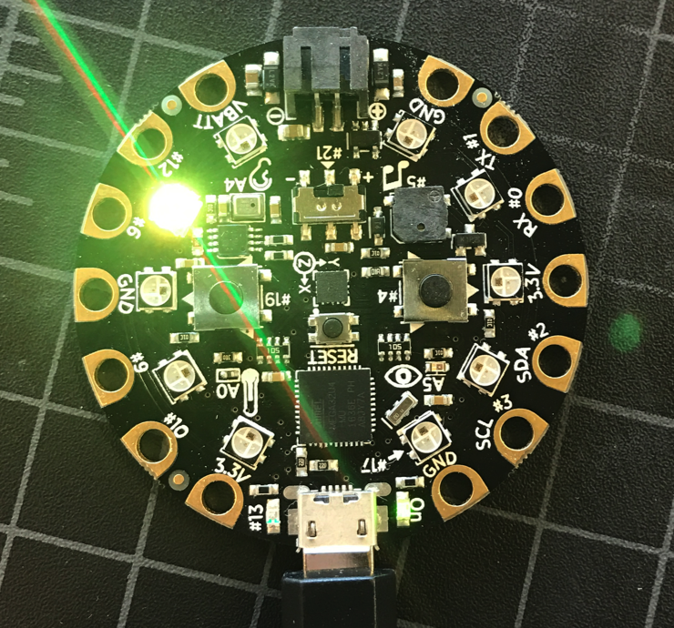
How Sensor Works
YES, HERE IS A CAR
Green light is on , which means here is a car.

Slide 13
After car leaves, the light will be off, and show the parking time and time fee on screen. Then repeat same steps from begin.

Slide 15
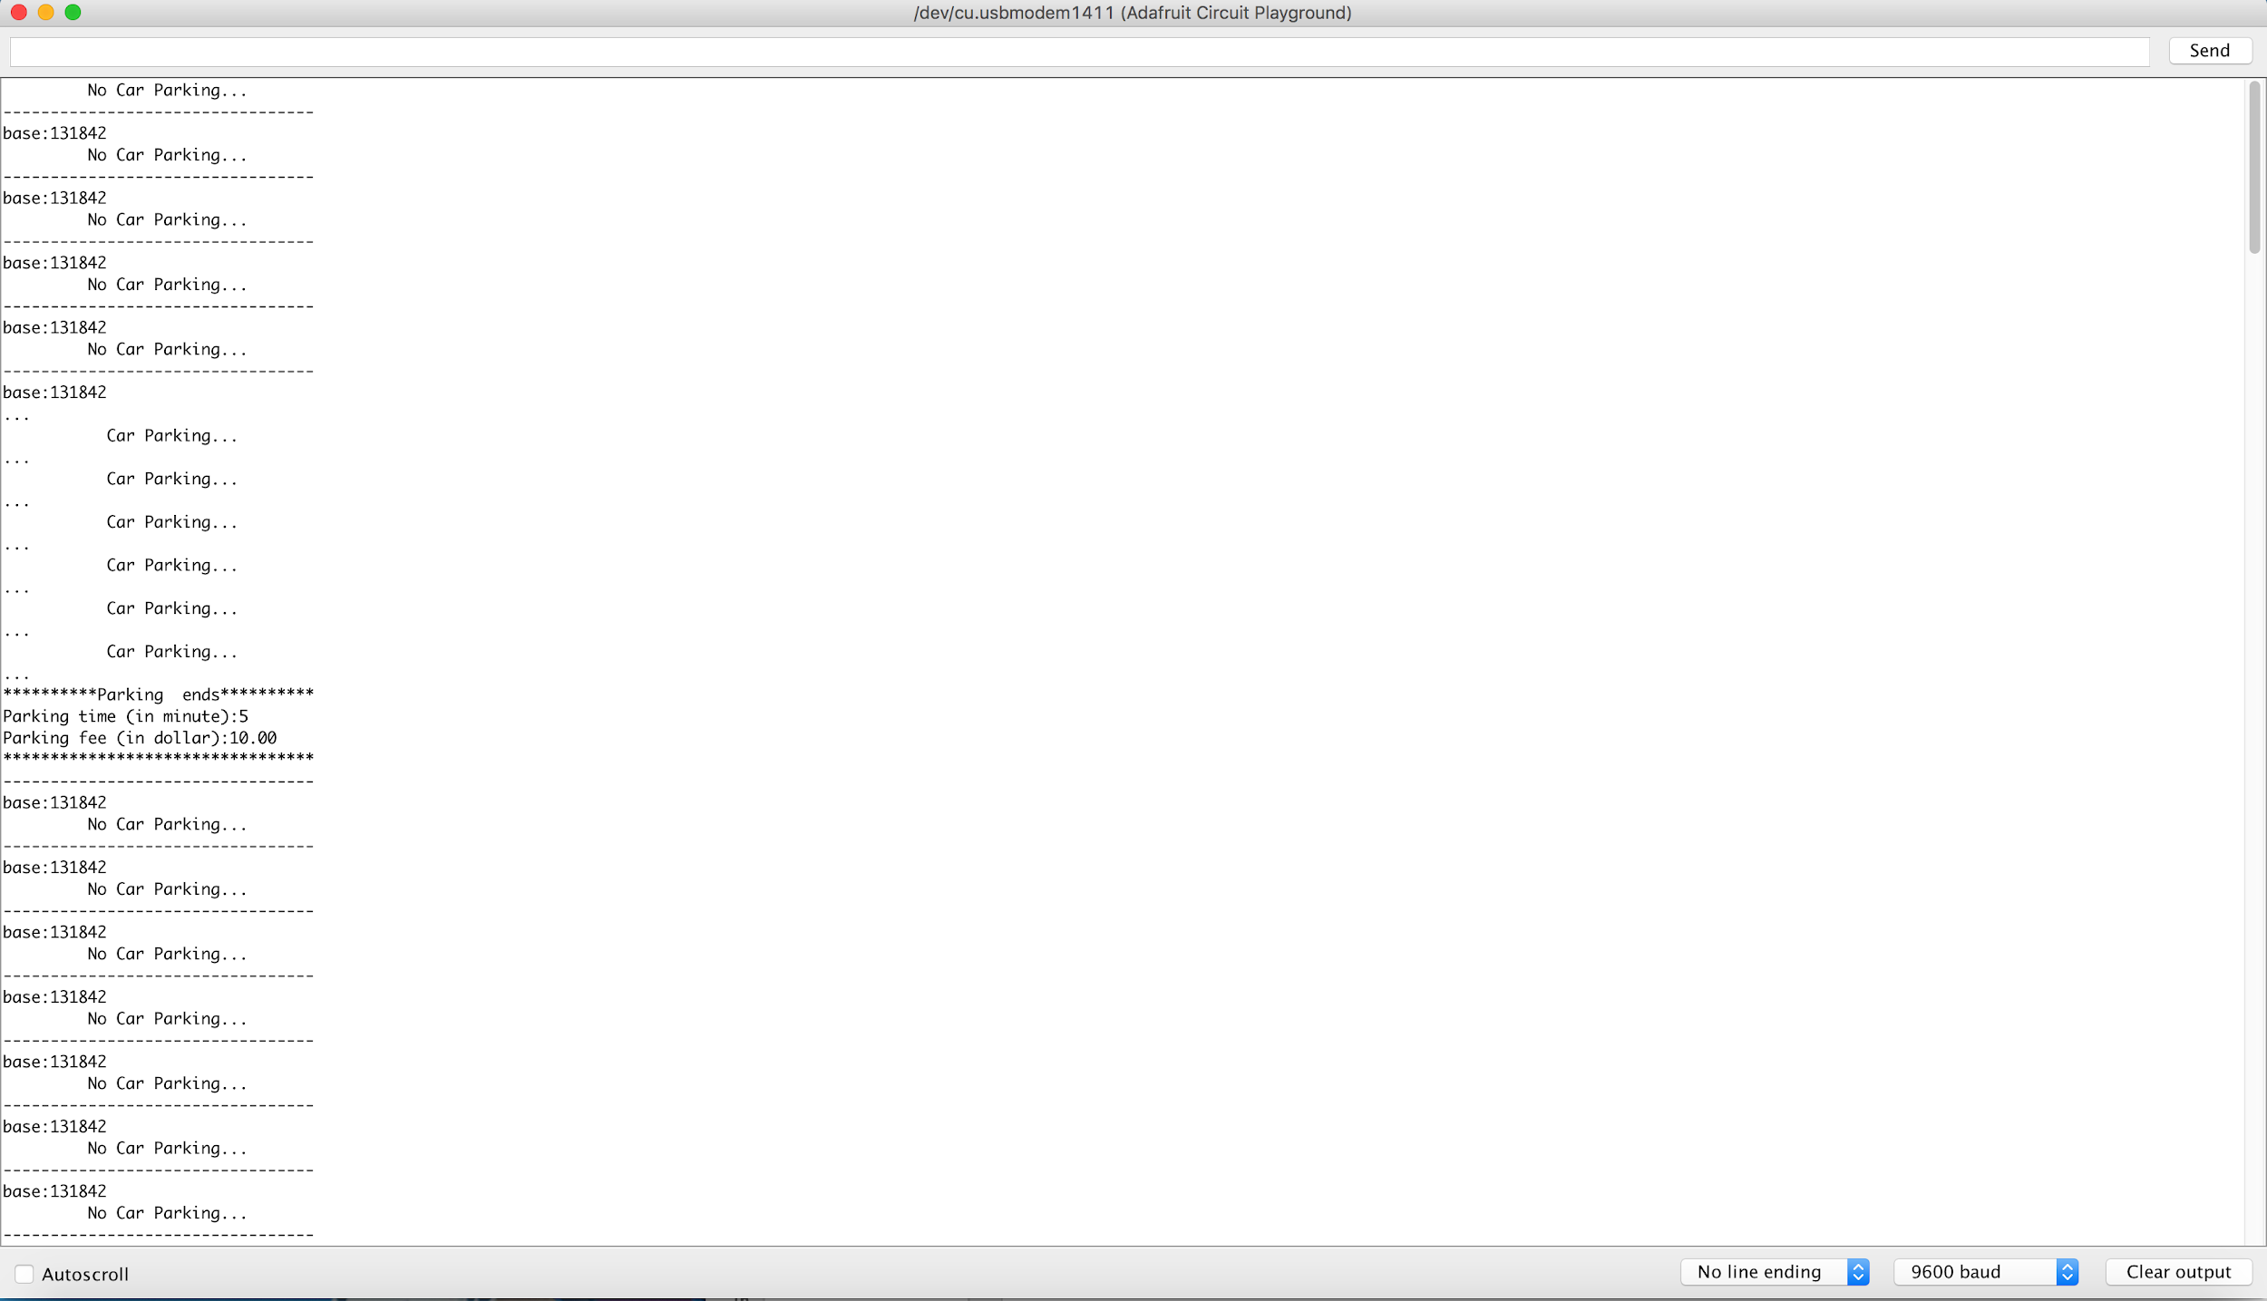

Slide 16
Summary and Future work
The QuikPark utilizes the sensor that detects the color of an object to determine whether a car is parked or not and to determine the duration it has been parked there for.
Ways to improve:
We can use a real time clock to countdown the time.
We can utilise different light sources (ex. laser).
The shape of the circuit board bothered us a lot, a smaller sized sensor would be more practical.
An outer protective shell for the sensor would increase durability.
A more sensitive sensor would help.

Slide 17
Questions to ask?

Slide 18
Thanks for listening !

